Slide 1
FOREST RESOURCE
Dr. Prasenjit Adak

Slide 2
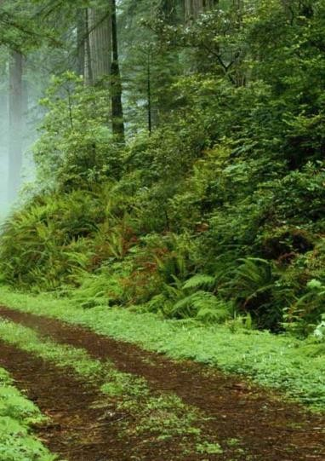
Forest Resource
A forest , a biotic community with predominance of trees is an important Renewable natural resource.
Types of forest
Very dense – above 70%
Moderately dense – 41 – 70%
Open forest – 10 – 40%
33% should be forest
24.39% in India
Average annual growth:
1990-2000: 0.22%
2000-2010: 0.46%
2010-2020: 0.38%

Slide 3
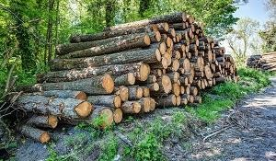
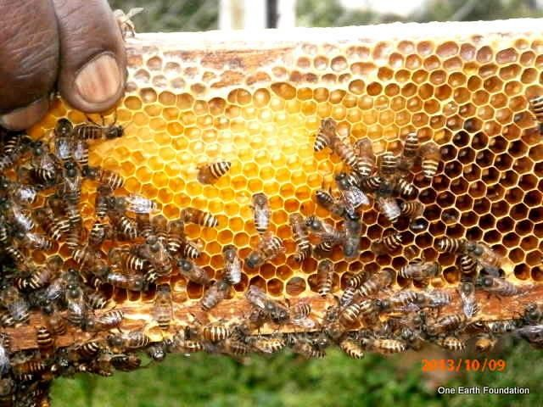
Functions of forests
Commercial use
Timber, pulpwood
Raw materials: oil, bamboo, cotton, jute, rubber, gum, fibers etc.
Edible products: Fruits, condiments, spices, Beverages, fodder
Manure, fuel wood
Medicines
Minerals
Employment opportunity
Recreation: Tourism

Slide 4
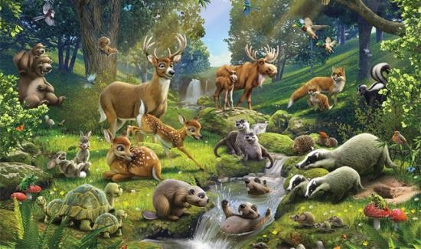
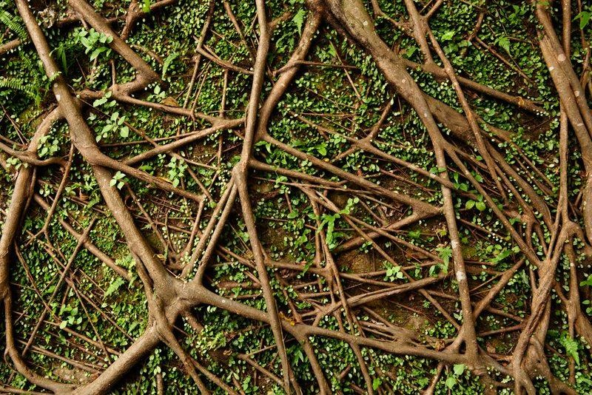
Functions of forests
Environmental functions
Regulation of hydrological cycles
Produces oxygen
Soil conservation
Pollutants moderators
Driving energy flow and nutrient cycle
Wild life habitat
Reducing Greenhouse gas

Slide 5
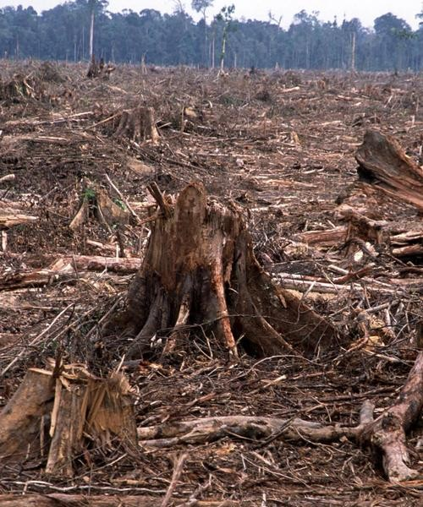
Over-exploitation of forests (Deforestation)
Causes
Extensive wood cutting and logging
Deforestation due to road construction
Clearing forest for agriculture
Overgrazing
Mining activities
Big hydropower projects
Forest fire

Slide 6
Over-exploitation of forests (Deforestation)
Effects
Threatens the existence of wildlife species
Biodiversity is lost
Hydrological cycle gets affected
Soil erosion and loss of soil fertility
Siltation of river and lakes
May lead to landside
Global warming
Flood
Loss of revenue
Socio-economic problems: Relocation, threat to culture and tradition

Slide 7
Over-exploitation of forests (Deforestation)
Control
Mining activities should be prohibited in protected forests
Cutting of trees should follow massive plantation
Environmental laws and legal provisions must be strictly followed
Social forestry, agro-forestry, recreational forestry, extension forestry
Public awareness
Participation in forest conservation programs

Slide 8
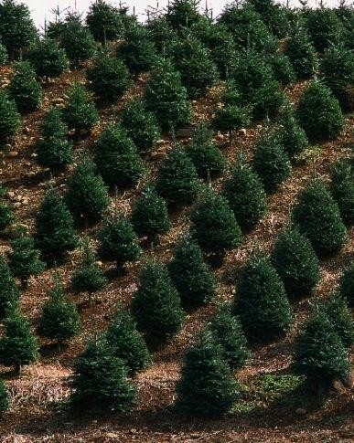
Control of deforestation
Control
Reforestation
Reforestation is the reestablishment of forest cover, either naturally or artificially in a deforested area.
Afforestation
Afforestation is the establishment of a forest or stand of trees in an area where there was no forest.

Slide 9
ENERGY RESOURCE
Dr. Prasenjit Adak

Slide 10
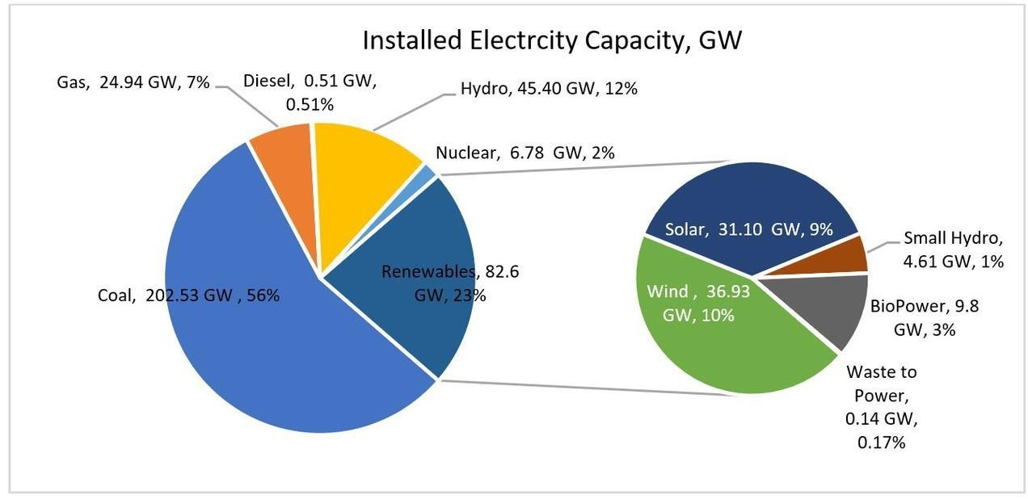
Energy resource
What is energy: Capacity to do work
Source of energy: Sun
Energy sources in India:

Slide 11
Renewable and non-renewable energy
Non-renewable
Sources: Coal, oil, natural gas, nuclear energy
Problems
Leakage during transportation – water pollution
Accidental fire – air pollution
Refinery waste – solid waste, salt, grease, cleaning of oil tankers
Vehicular emission
Renewable
Solar energy, wind energy, hydro-power, Tidal energy, Ocean thermal energy, Geo thermal energy, biomass energy, biogas, biofuel, hydrogen fuel
[Note: Alternative sources of energy = Non-fossil fuel sources]

Slide 12
Non-renewable resources
Coal
Types of coal
Anthracite: The highest rank of coal. It is a hard, brittle, and black lustrous coal, often referred to as hard coal, containing a high percentage of fixed carbon and a low percentage of volatile matter.
Bituminous: Bituminous coal is a middle rank coal between subbituminous and anthracite. Bituminous usually has a high heating (Btu) value and is the most common type of coal used in electricity generation in the United States. Bituminous coal appears shiny and smooth when you first see it, but look closer and you may see it has layers.
Subbituminous: Subbituminous coal is black in color and dull (not shiny), and has a higher heating value than lignite.
Lignite: Lignite coal, aka brown coal, is the lowest grade coal with the least concentration of carbon.
Also, there is peat. Peat is not actually coal, but rather the precursor to coal. Peat is a soft organic material consisting of partly decayed plant and, in some cases, deposited mineral matter. When peat is placed under high pressure and heat, it becomes coal.

Slide 13
Non-renewable resources
Petroleum
Organization of Petroleum Exporting Countries (OPEC) consists of 13 countries and having 67% of worlds petroleum reserve.
Petroleum is a complex mixture of alkane hydrocarbons.
It is purified and refined by the process of fractional
distillation.
Petroleum is a cleaner fuel as compared to coal.
Petroleum products
Petroleum gas, kerosene, petrol, diesel, lubricating oil, paraffin, wax, asphalt, plastic etc.
Liquefied Petroleum Gas: mainly composed of butane,
other being propane and ethane.

Slide 14
Non-renewable resources
Natural gas
Natural gas is the cleanest fossil fuel.
composed of 95% methane, small amount of propane and ethane.
It has been formed by decomposing remains of dead plants and animals.
It has high calorific value (about 50 KJ/g)
Compressed Natural Gas (CNG): It is used as an alternative to petrol and diesel in many cities including Delhi.
Synthetic Natural Gas (SNG): It is a mixture of carbon monoxide and hydrogen. Low grade coal is first transformed into synthetic gas, then into methane by catalytic conversion.

Slide 15
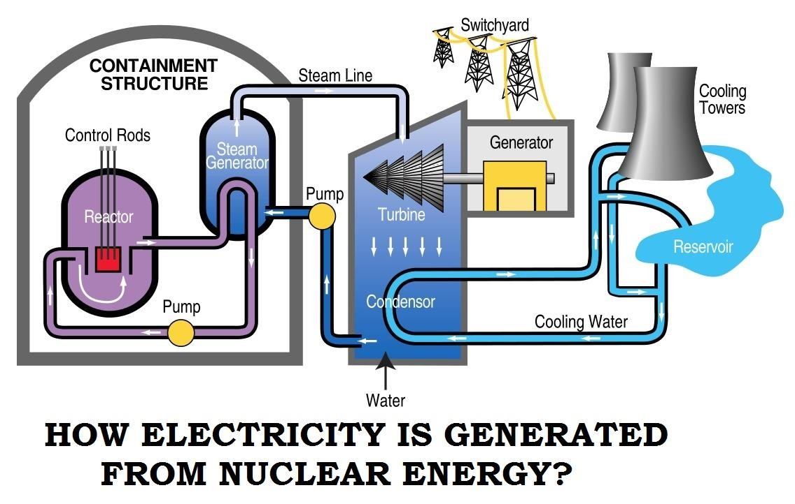
Nuclear energy
Types of nuclear reactions
Fission: Splitting of large nucleus into smaller nuclei.
Fusion: Joining of small nuclei into a large nucleus.
Elements used in nuclear energy production: Uranium, Thorium, Plutonium
Advantages:
Less fuel offers more energy.
The cost of nuclear fuel is only 20% of the cost of energy generated.
The production of electric energy is continuous (almost 90% of annual time).
Disadvantages:
Risk of unexpected event or nuclear accidents.
Difficulty in the management of nuclear waste.
Nuclear plants have a limited life.

Slide 16
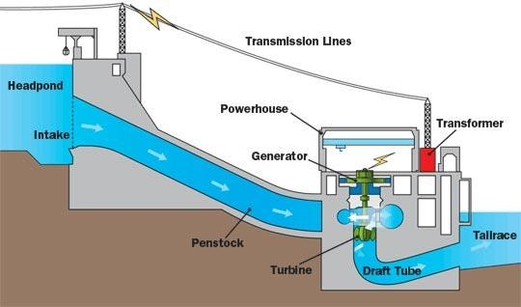
Hydro-electric energy
The potential energy in the water stored in dams is converted into electrical energy by releasing the water flow and rotating the turbine
Advantages
Low operating and maintenance cost
Non-polluting
Reliable
Flexible
Safe
Disadvantages
High setup cost
Affects fish population
Limited reservoirs
Affected by draught
Probable seismic activity

Slide 17
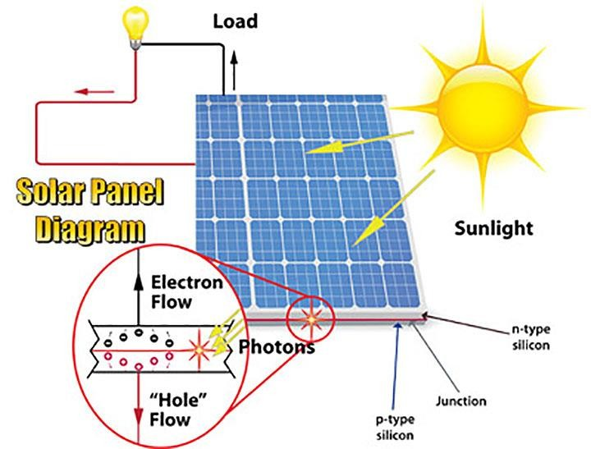
Solar energy
1 hour solar energy can be used for 1 year
Uses of solar energy
Solar heating of home (sunspace)
Solar water heating, solar cooker, solar
furnace
Solar desalination system
Photovoltaic energy: Silicon -> PV cells -> PV modules -> PV array -> solar panel
Advantages
Easy to install
No pollution, no noise
Can be installed anywhere
Disadvantages
Doesn’t work when light is not available
Requires energy storage device
Low efficiency
Damage easily

Slide 18
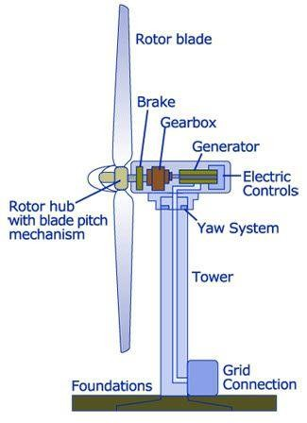
Wind energy
One of the earliest renewable energy – sail ships, windmills
India is the 4th largest producer of wind energy (after China, US and Germany).
Advantages
Unlimited, free, renewable resource
Low maintenance cost
No pollution
Disadvantages
High setup cost
Birds and bats get killed
Noise and signal reception problem

Slide 19
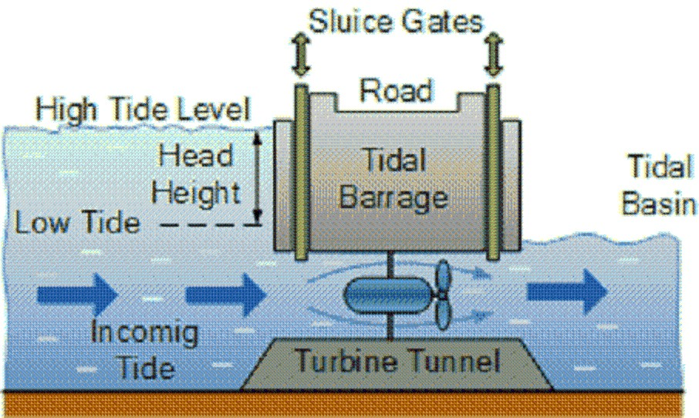
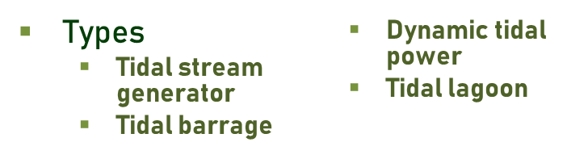
Tidal energy
Tidal power or tidal energy is a form of hydropower that converts the energy obtained from tides into electricity.
Advantages
Tides are more predictable than the wind and the sun
Uses less area.
No emission of gaseous or
particulate pollutants
Disadvantages
Electro-magnetic emission affects the aquatic life.
High construction cost

Slide 20
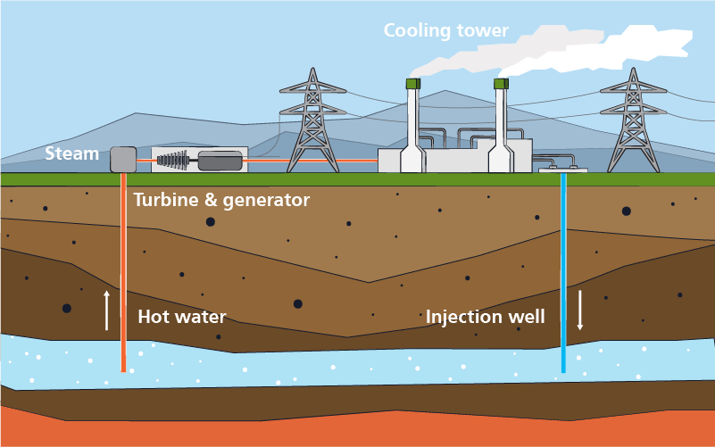
Geo-thermal energy
The energy harnessed from the hot rocks present inside the earth is called geothermal energy.
Sometimes natural geysers or artificially drilled holes can be used to released the water vapour underneath the earth surface.
Advantages
No pollutant emission
Reliable source of renewable energy
Less operating cost
Less maintenance cost
Disadvantages
Possibility of emissions of H₂S, CO₂, CH₄ during extraction
High Investment Costs

Slide 21
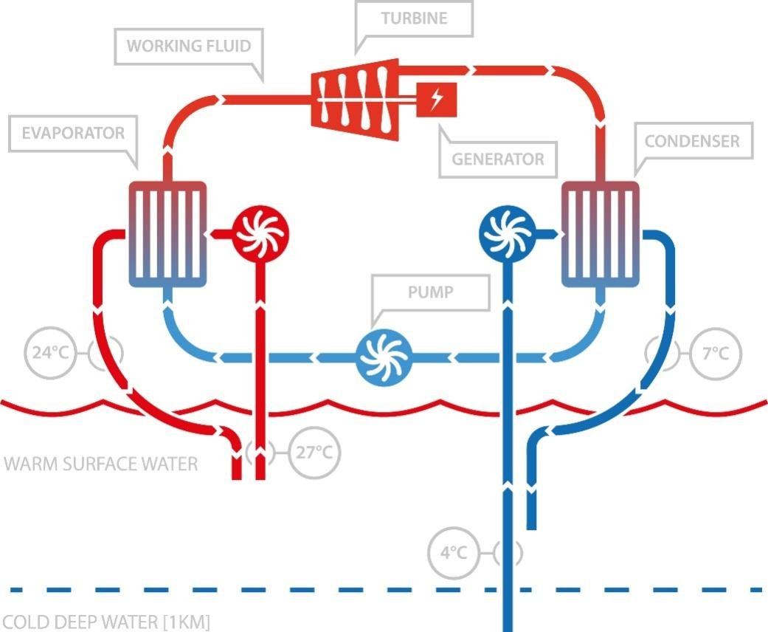
Ocean-thermal energy
The energy available due to the difference in temperature of water at the surface of tropical oceans and deeper levels is called ocean-thermal energy.
A difference of at least 20⁰ C is required
The heat is used to vaporize ammonia and rotate the turbine sing the vapour.
Advantages
Continuous source of energy
No pollutant emission
Output shows very little seasonal
variation
Disadvantages
Capital investment is very high
High maintenance cost
Low efficiency
Pipes could damage coral reefs

Slide 22
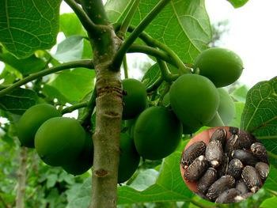
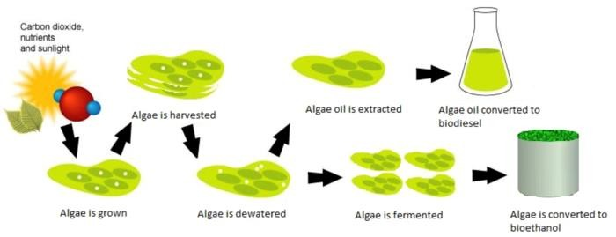
Biomass energy
Log burning is a simple way use biomass energy
Wood is the largest source of biomass energy. It can also be used in electricity production in wood-based power stations.
Energy crop
An energy crop is a plant grown as a low-cost and low- maintenance harvest used to make biofuels, such as bioethanol, or combusted for its energy content to generate electricity or heat. Example: Jatropha, Sunflower etc.
Energy trapped inside biomass
Biofuels
Biodiesel
Biogas
Bio-ethanol
Bio-methanol

Slide 23
Energy recovery
Getting energy by burning the waste
Advantages
Reduced number of coal fired power plants
Reduced airborne particles
Improved air quality
Lower fuel bills on transport
Longer availability of crude oil
Reduction of waste volume (up to 90%)
Less requirement of landfill space
Disadvantages
Release of toxic substances
Residual ash may contain heavy metal

Slide 24
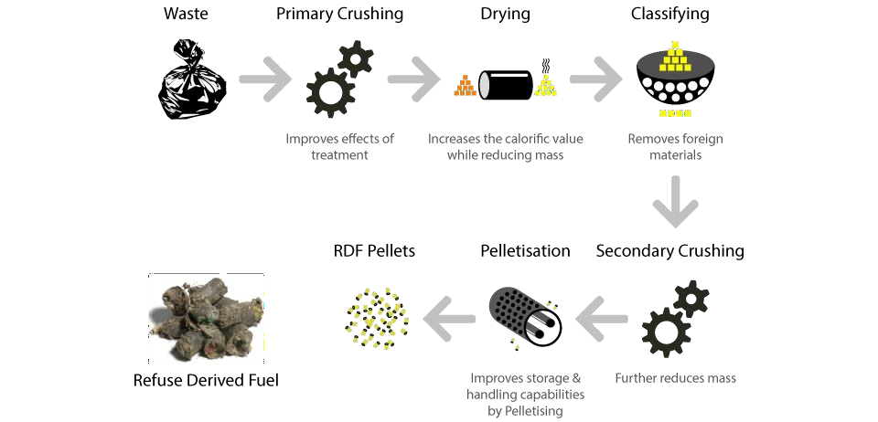
Refuse Derived Fuel (RDF)
RDF consists largely of combustible components of such
waste, as non recyclable plastics , paper cardboard, labels etc.
These fractions are separated by different processing steps in order to produce a homogeneous material which can be used as substitute for fossil fuels

Slide 25
Thank You

